Slide 1
Cyclistic ride-sharing analysis
Differentiating casual riders from annual members to inform the upcoming marketing campaign.

Slide 2
Objective
Cyclistic is a fictitious alias for a bicycle ridesharing company in Chicago. The goal of this mock is to help inform the marketing team, whose campaign is aimed towards converting “casual riders” into annual members. Towards this aim, I identify key differences between the groups and general patterns in casual riding to provide opportunities for effective marketing.

Slide 3
Data
The data used was provided in csv files by month. We only consider the last 12 months in our analysis.

Slide 4
Data
The 12 separate csv files were loaded into dataframes and subsequently concatenated together for a master dataframe with ~5.75 million rows and 13 columns:
Ride ID
Rideable type: “classic”, “electric”, or “docked”
Datetimes of when ride started and ended (2 separate columns)
Station names and IDs for starting station and ending station (4 cols)
Latitude and longitude coordinates for each starting and ending station (4 cols)
Membership status: “member” or “casual”

Slide 5
Data Cleaning
140 rides had the start time later than the end time, resulting in negative time spent on the bike.
Solution: I swapped the start and end times for these rides. Due to the small relative amount and impossibility of accuracy, I could’ve dropped these observations instead but chose to potentially save as much data as possible.
790,000 observations were missing starting station names while 843,000 observations were missing ending station names, with a good deal of overlap. 4,766 observations were missing ending latitude and longitude coordinates, all these observations overlapped with those missing ending station names.
Solution: There’s no way to know where the 4,766 rides ended so those observations were dropped. For the rest of the missing data, a dictionary was created matching station names with known latitude and longitude coordinates and then using this dictionary to determine the missing station names based on their coordinates.
Some bias may be introduced as all the 4,766 dropped rides used electric bikes

Slide 6
analysis
There are four key differences and/or patterns that were identified:
What
When
How Long
Where

Slide 7
whAT
Cyclistic offers 3 rideables:
Classic bike
Electric bike
Docked bike
How are member and casual rides distributed over these?

Slide 8
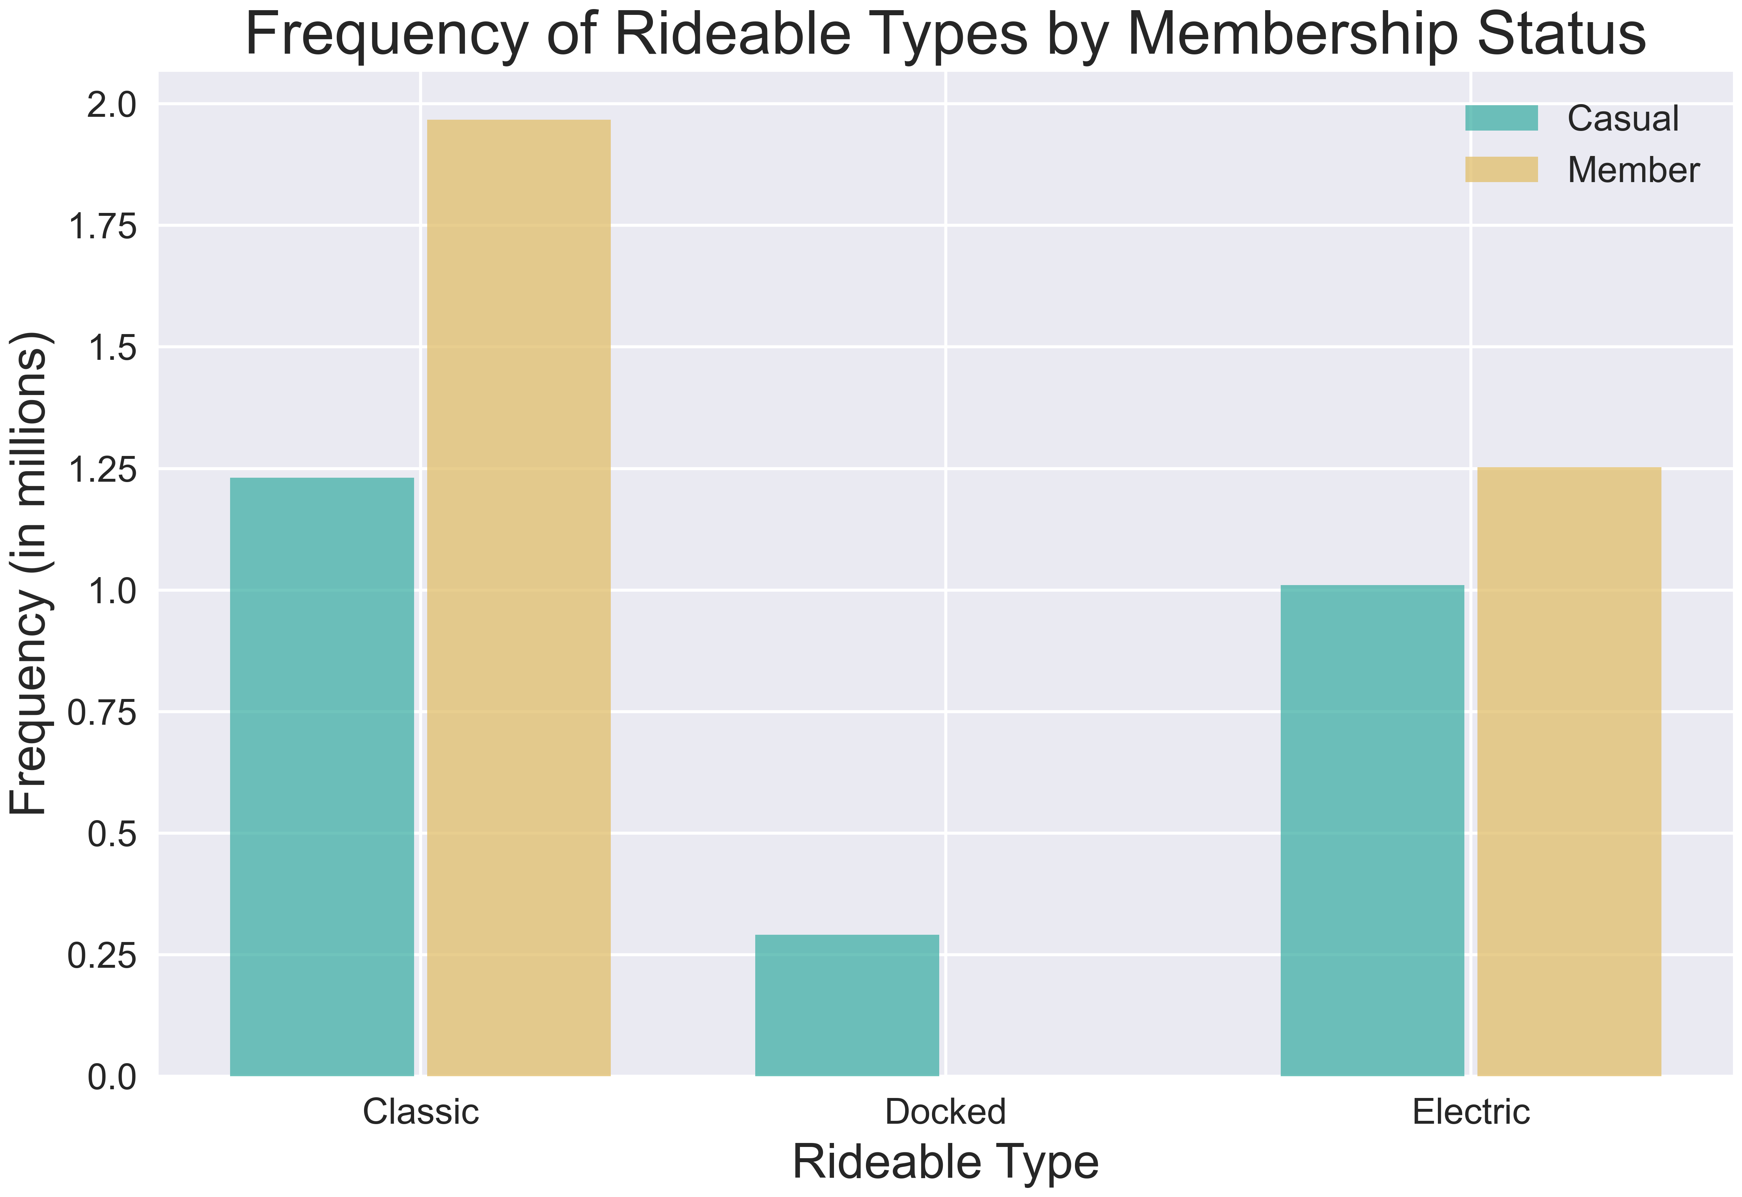
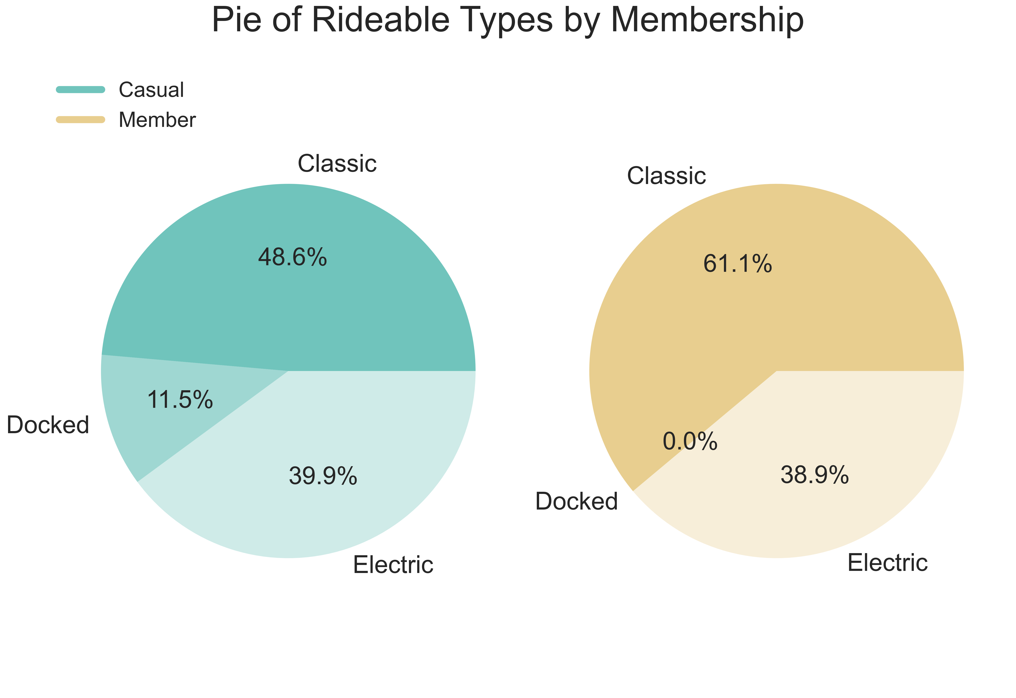
What
While members and casuals ride electric at the same rate, only one member ride was on a docked bike this past year. The difference is made up in classic bike rides.

Slide 9
analysis
There are four key differences and/or patterns that were identified:
What
When
How Long
Where

Slide 10
When
When do casual riders and members ride bikes?
There are 3 levels of “when”:
Yearly scale over months
Weekly scale over days
Daily scale over hours/minutes

Slide 11
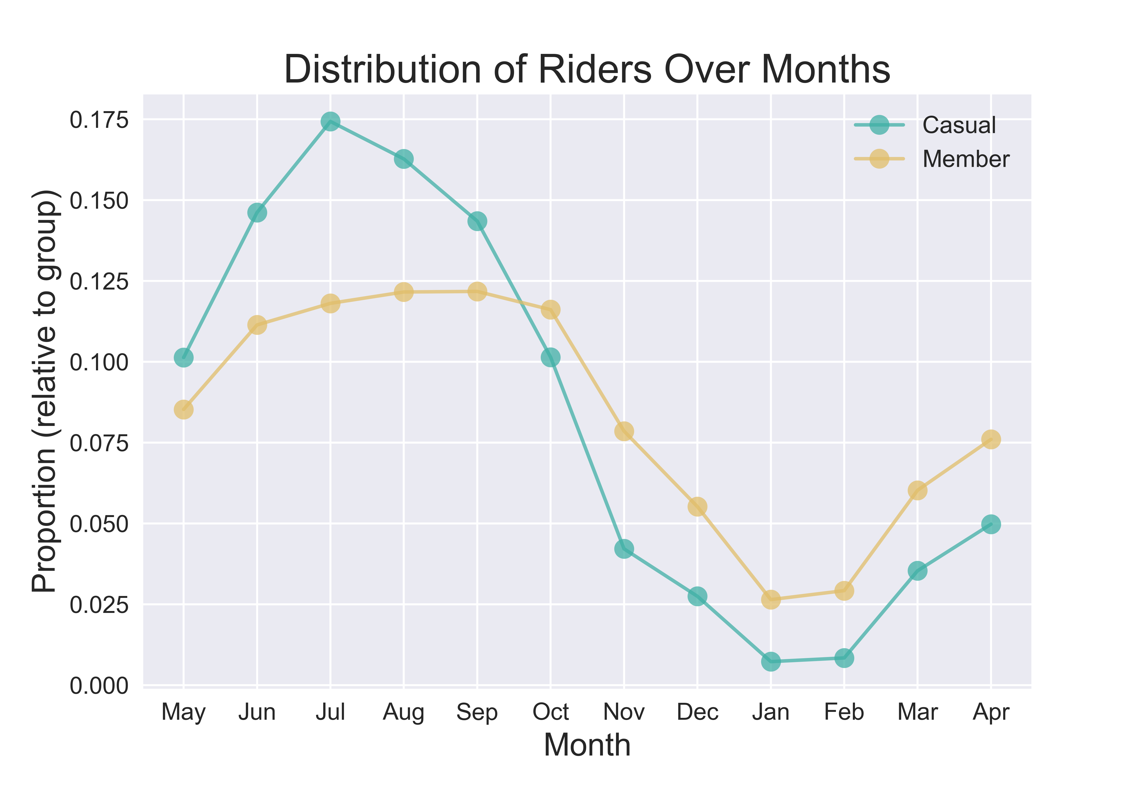
When
There are 3 levels of “when”:
Yearly scale over months
Weekly scale over days
Daily scale over hours/minutes

Slide 12
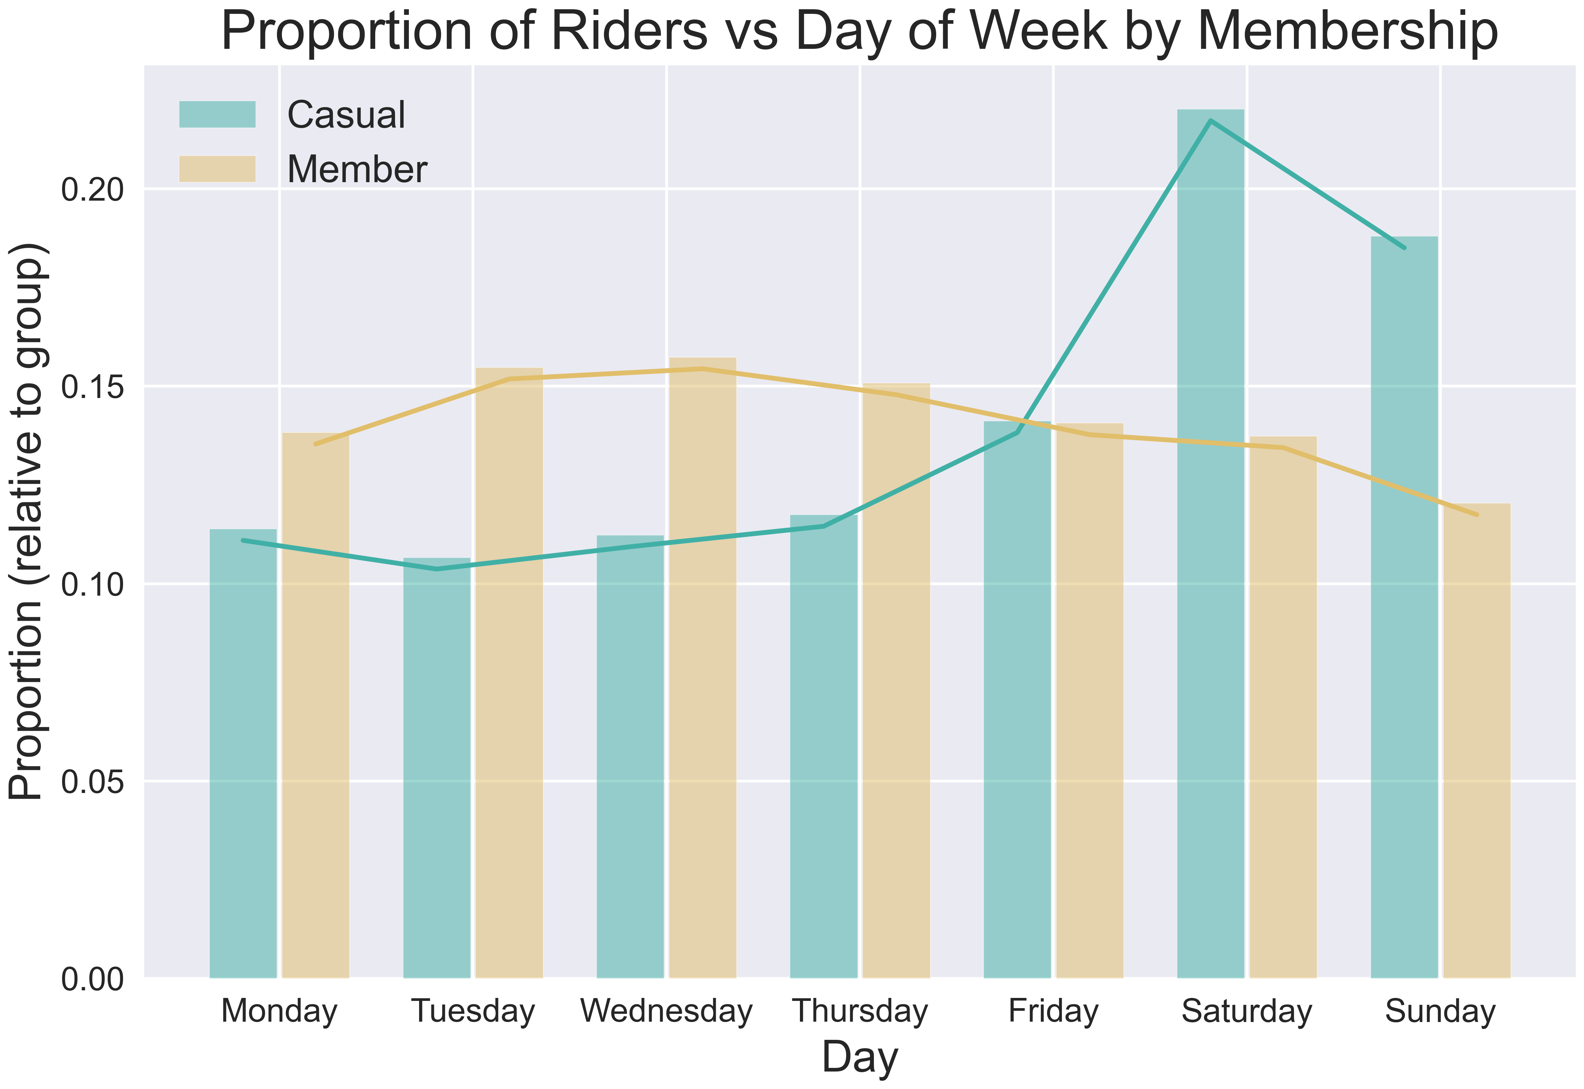
When
There are 3 levels of “when”:
Yearly scale over months
Weekly scale over days
Daily scale over hours/minutes

Slide 13
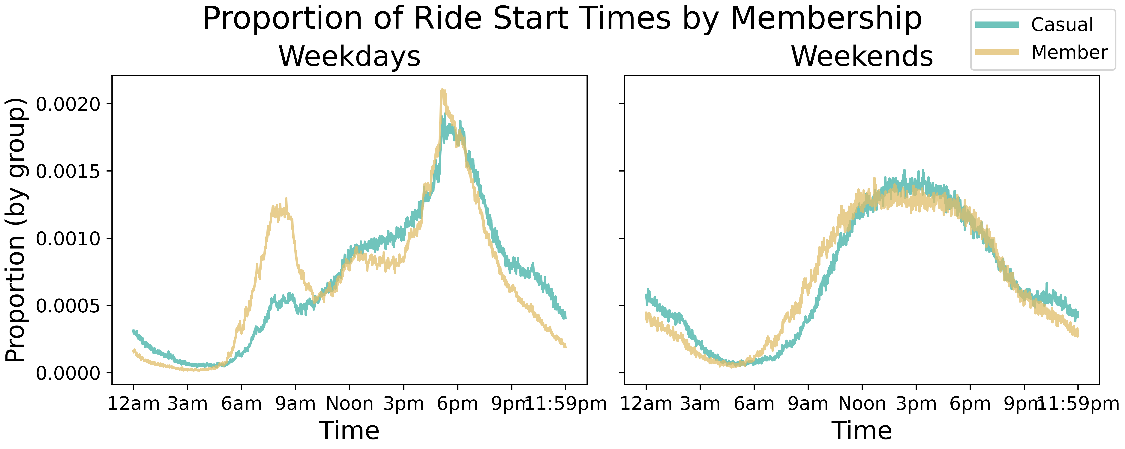
When
There are 3 levels of “when”:
Yearly scale over months
Weekly scale over days
Daily scale over hours/minutes

Slide 14
analysis
There are four key differences and/or patterns that were identified:
What
When
How Long
Where

Slide 15
How long
The ride_length column was created by taking the difference between start and end times, kept in minutes.
There are some large outliers in the data here (e.g., times well over 30 days) so 1% trimmed statistics were used
The ride_length data was analyzed against multiple categorical variables

Slide 16
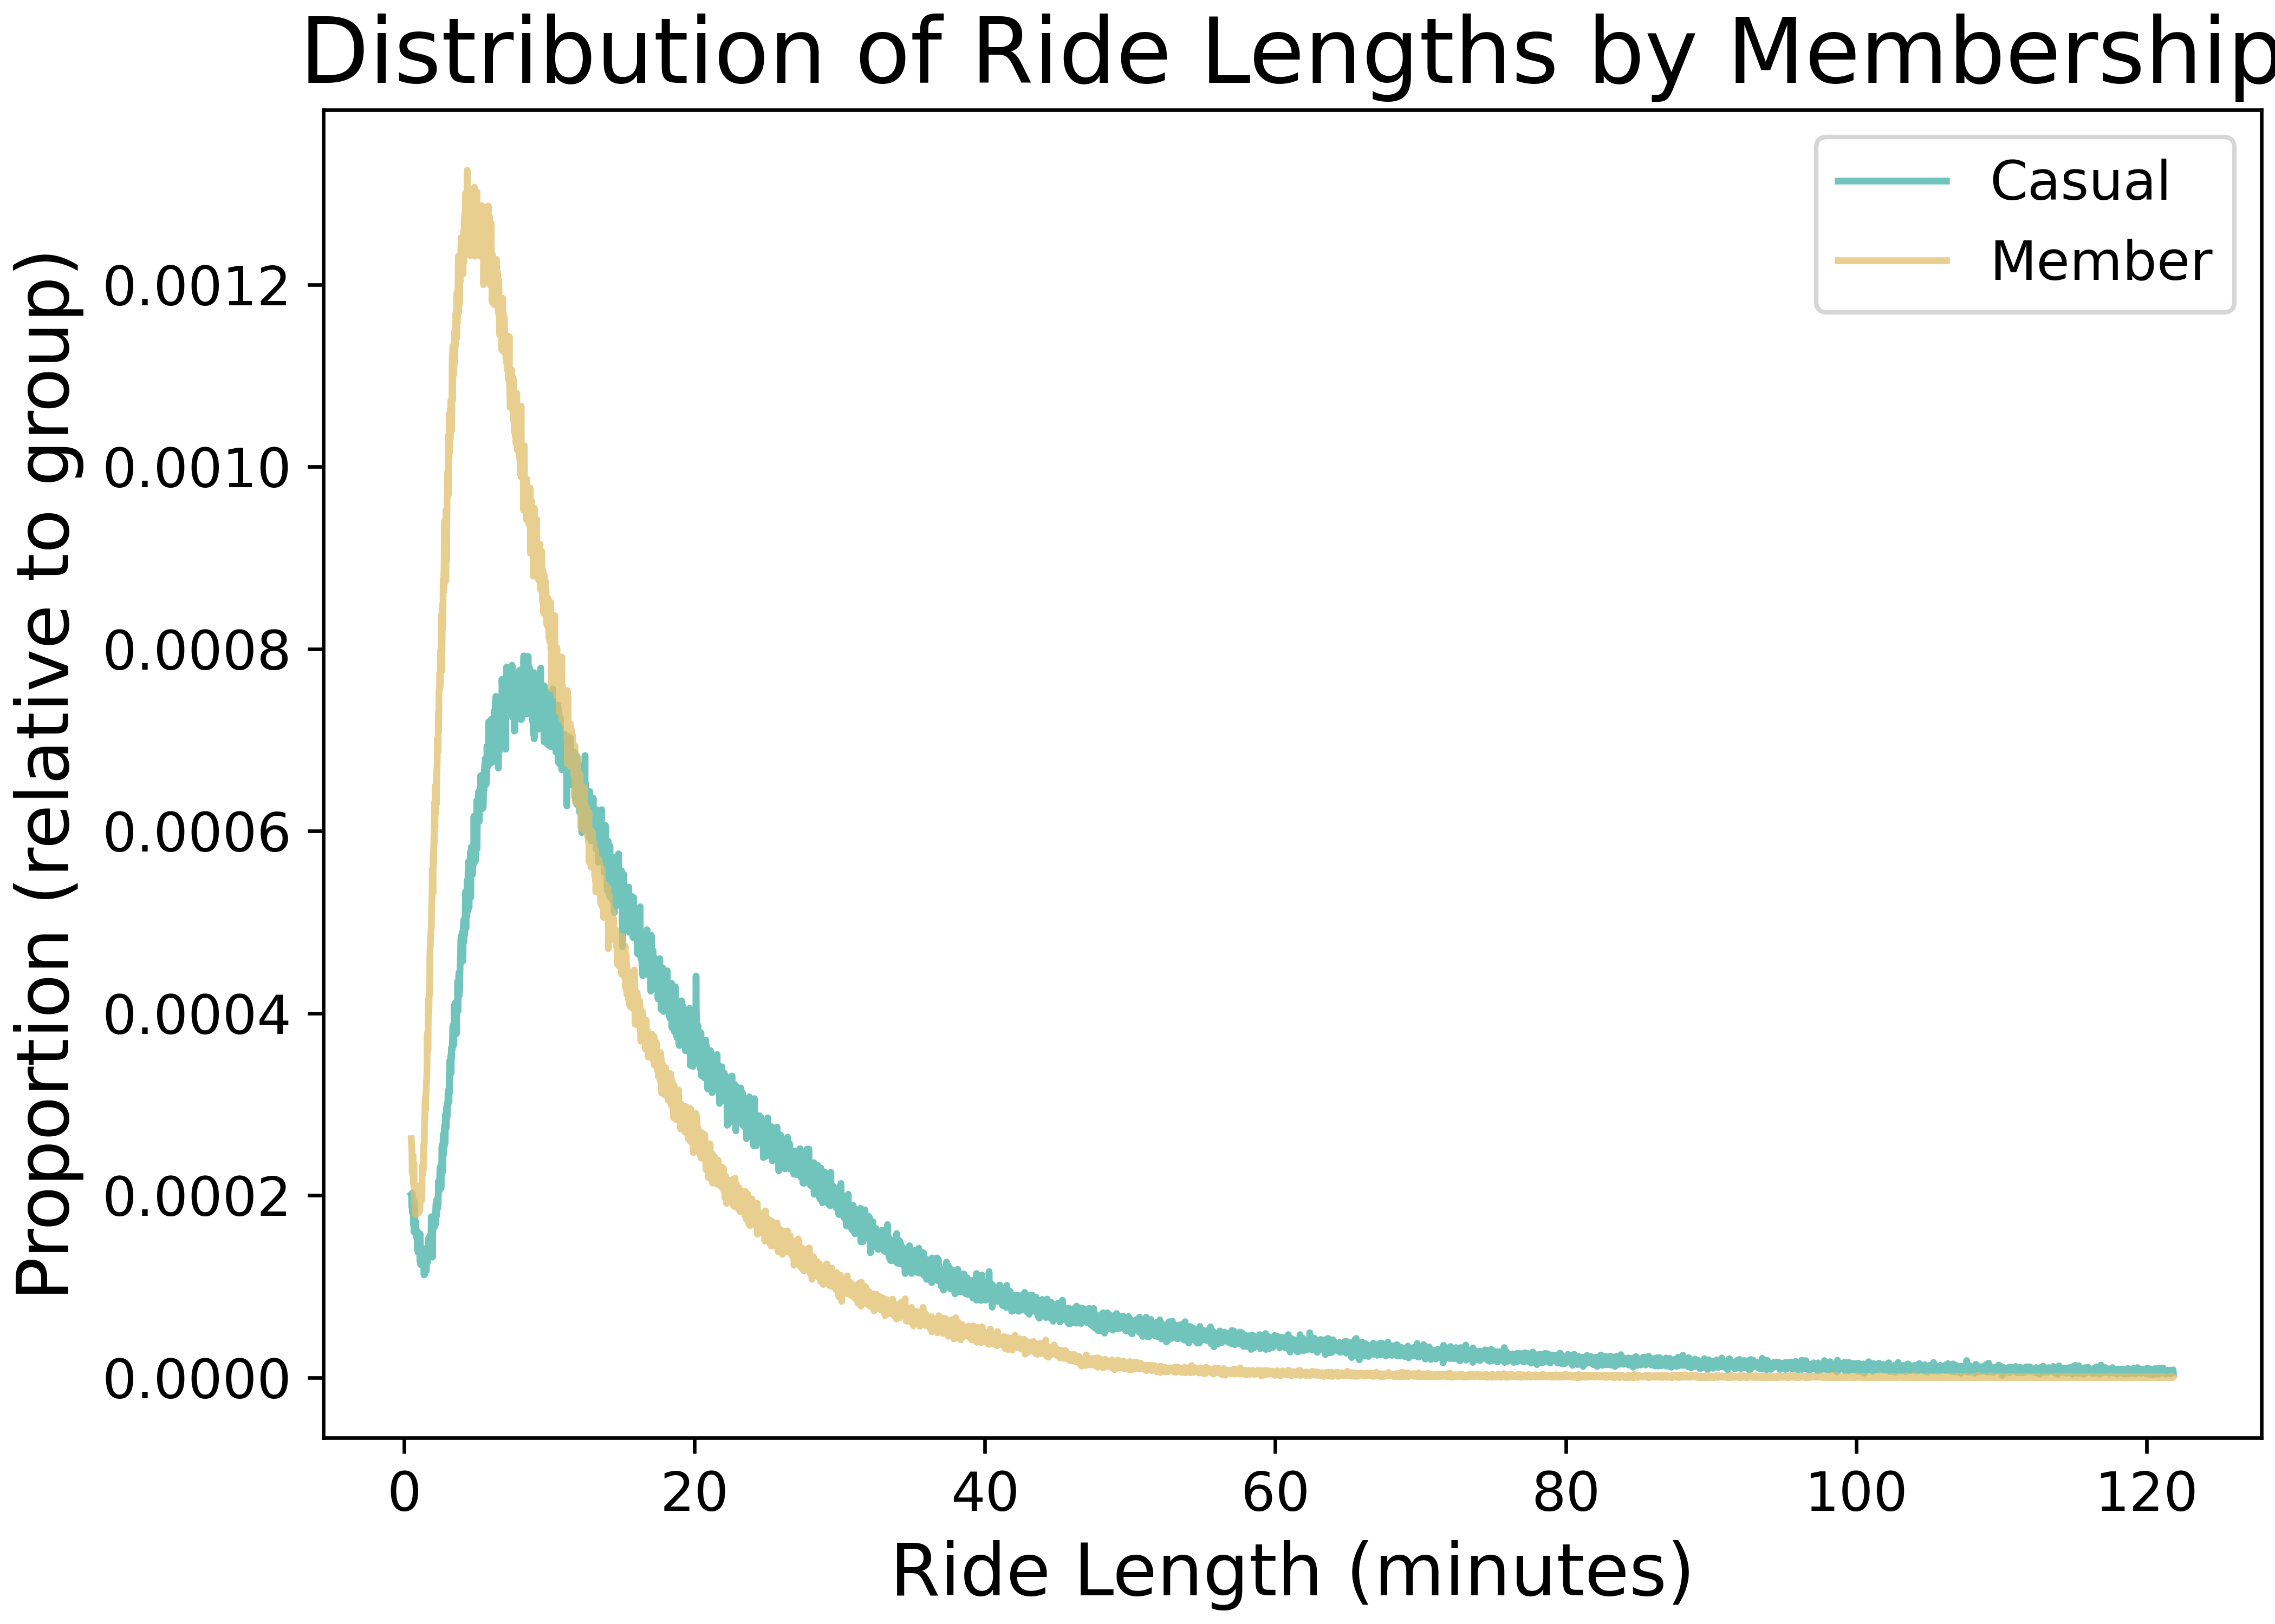
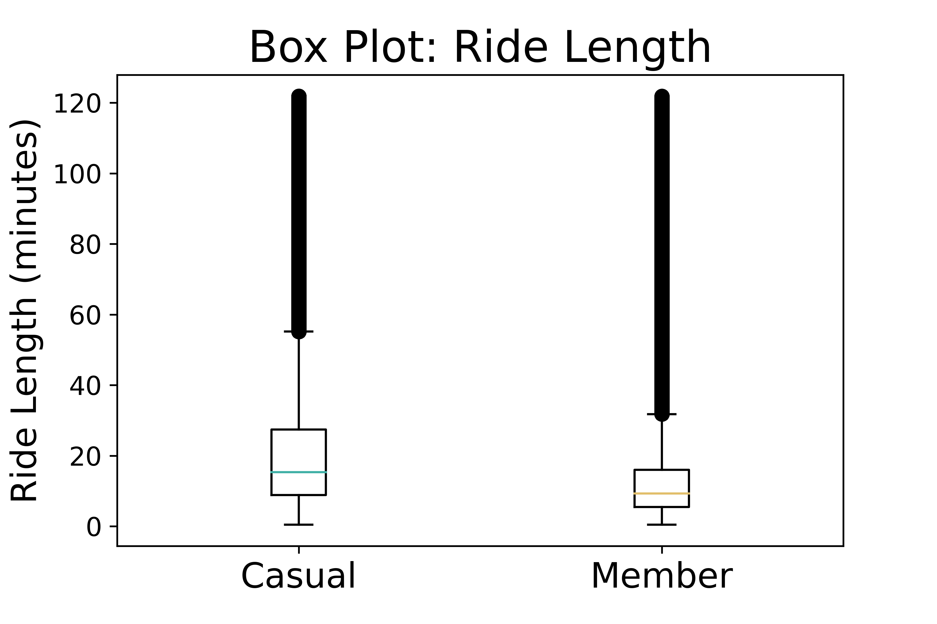
How long

Slide 17
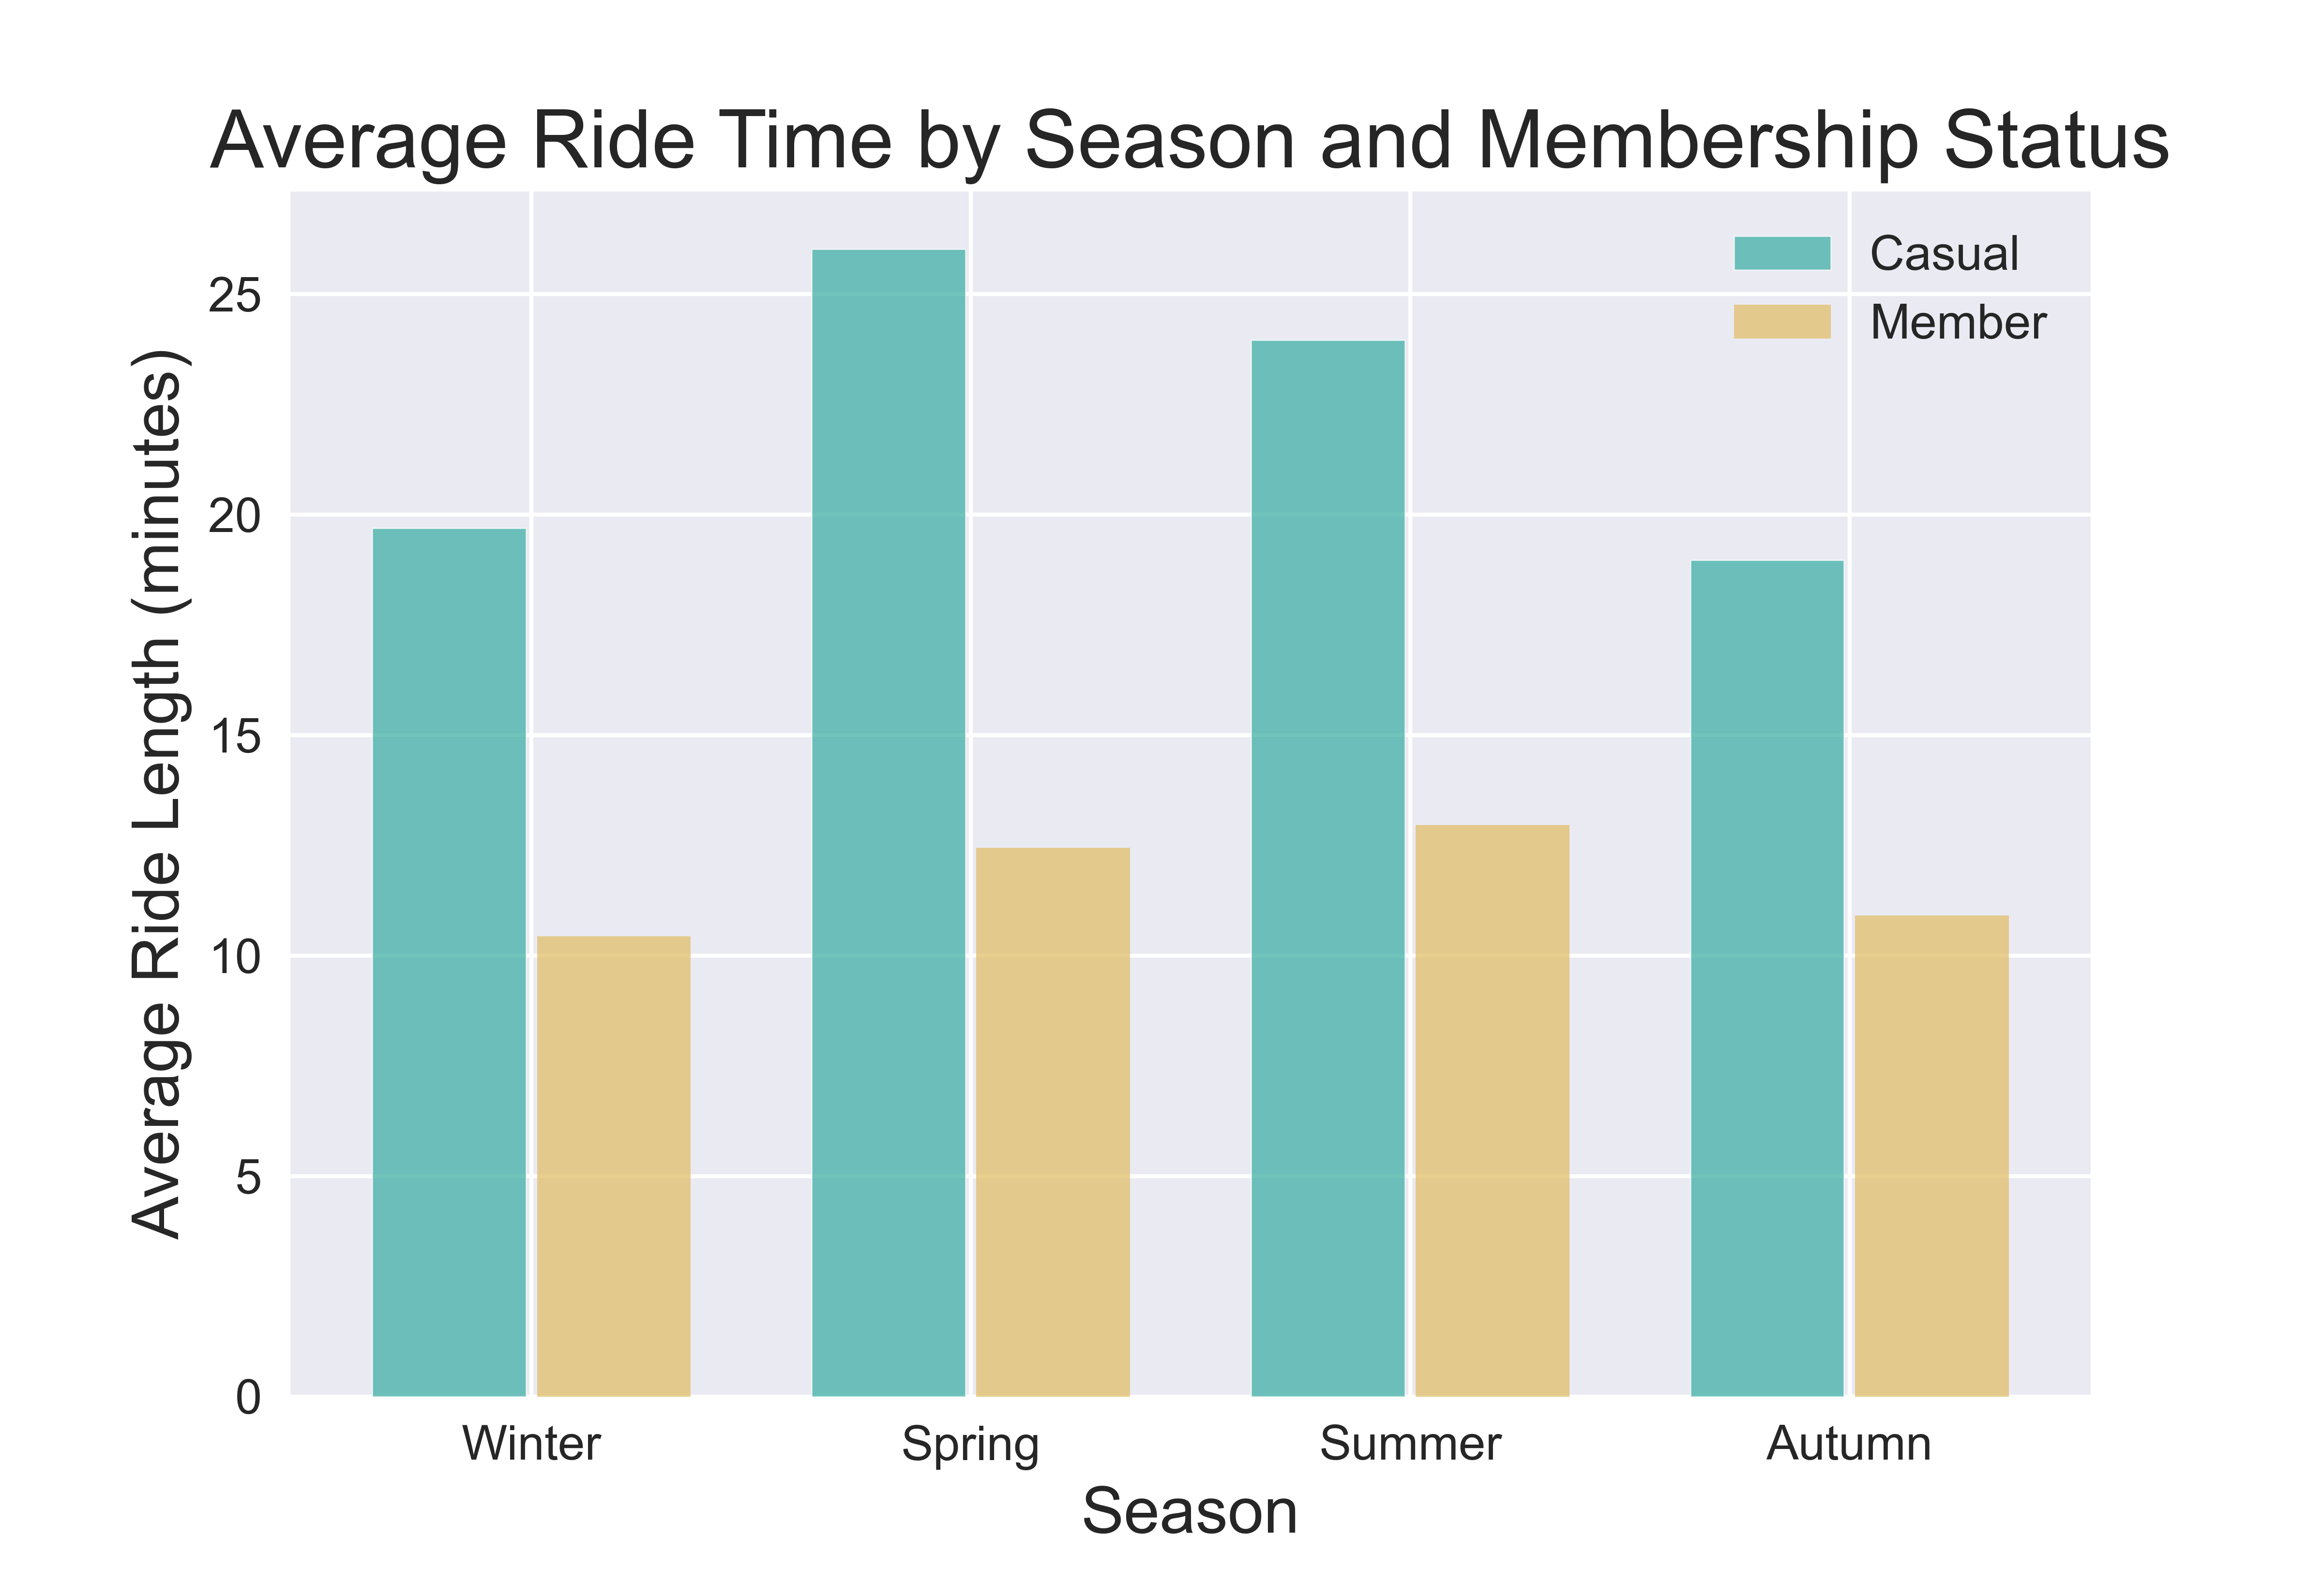
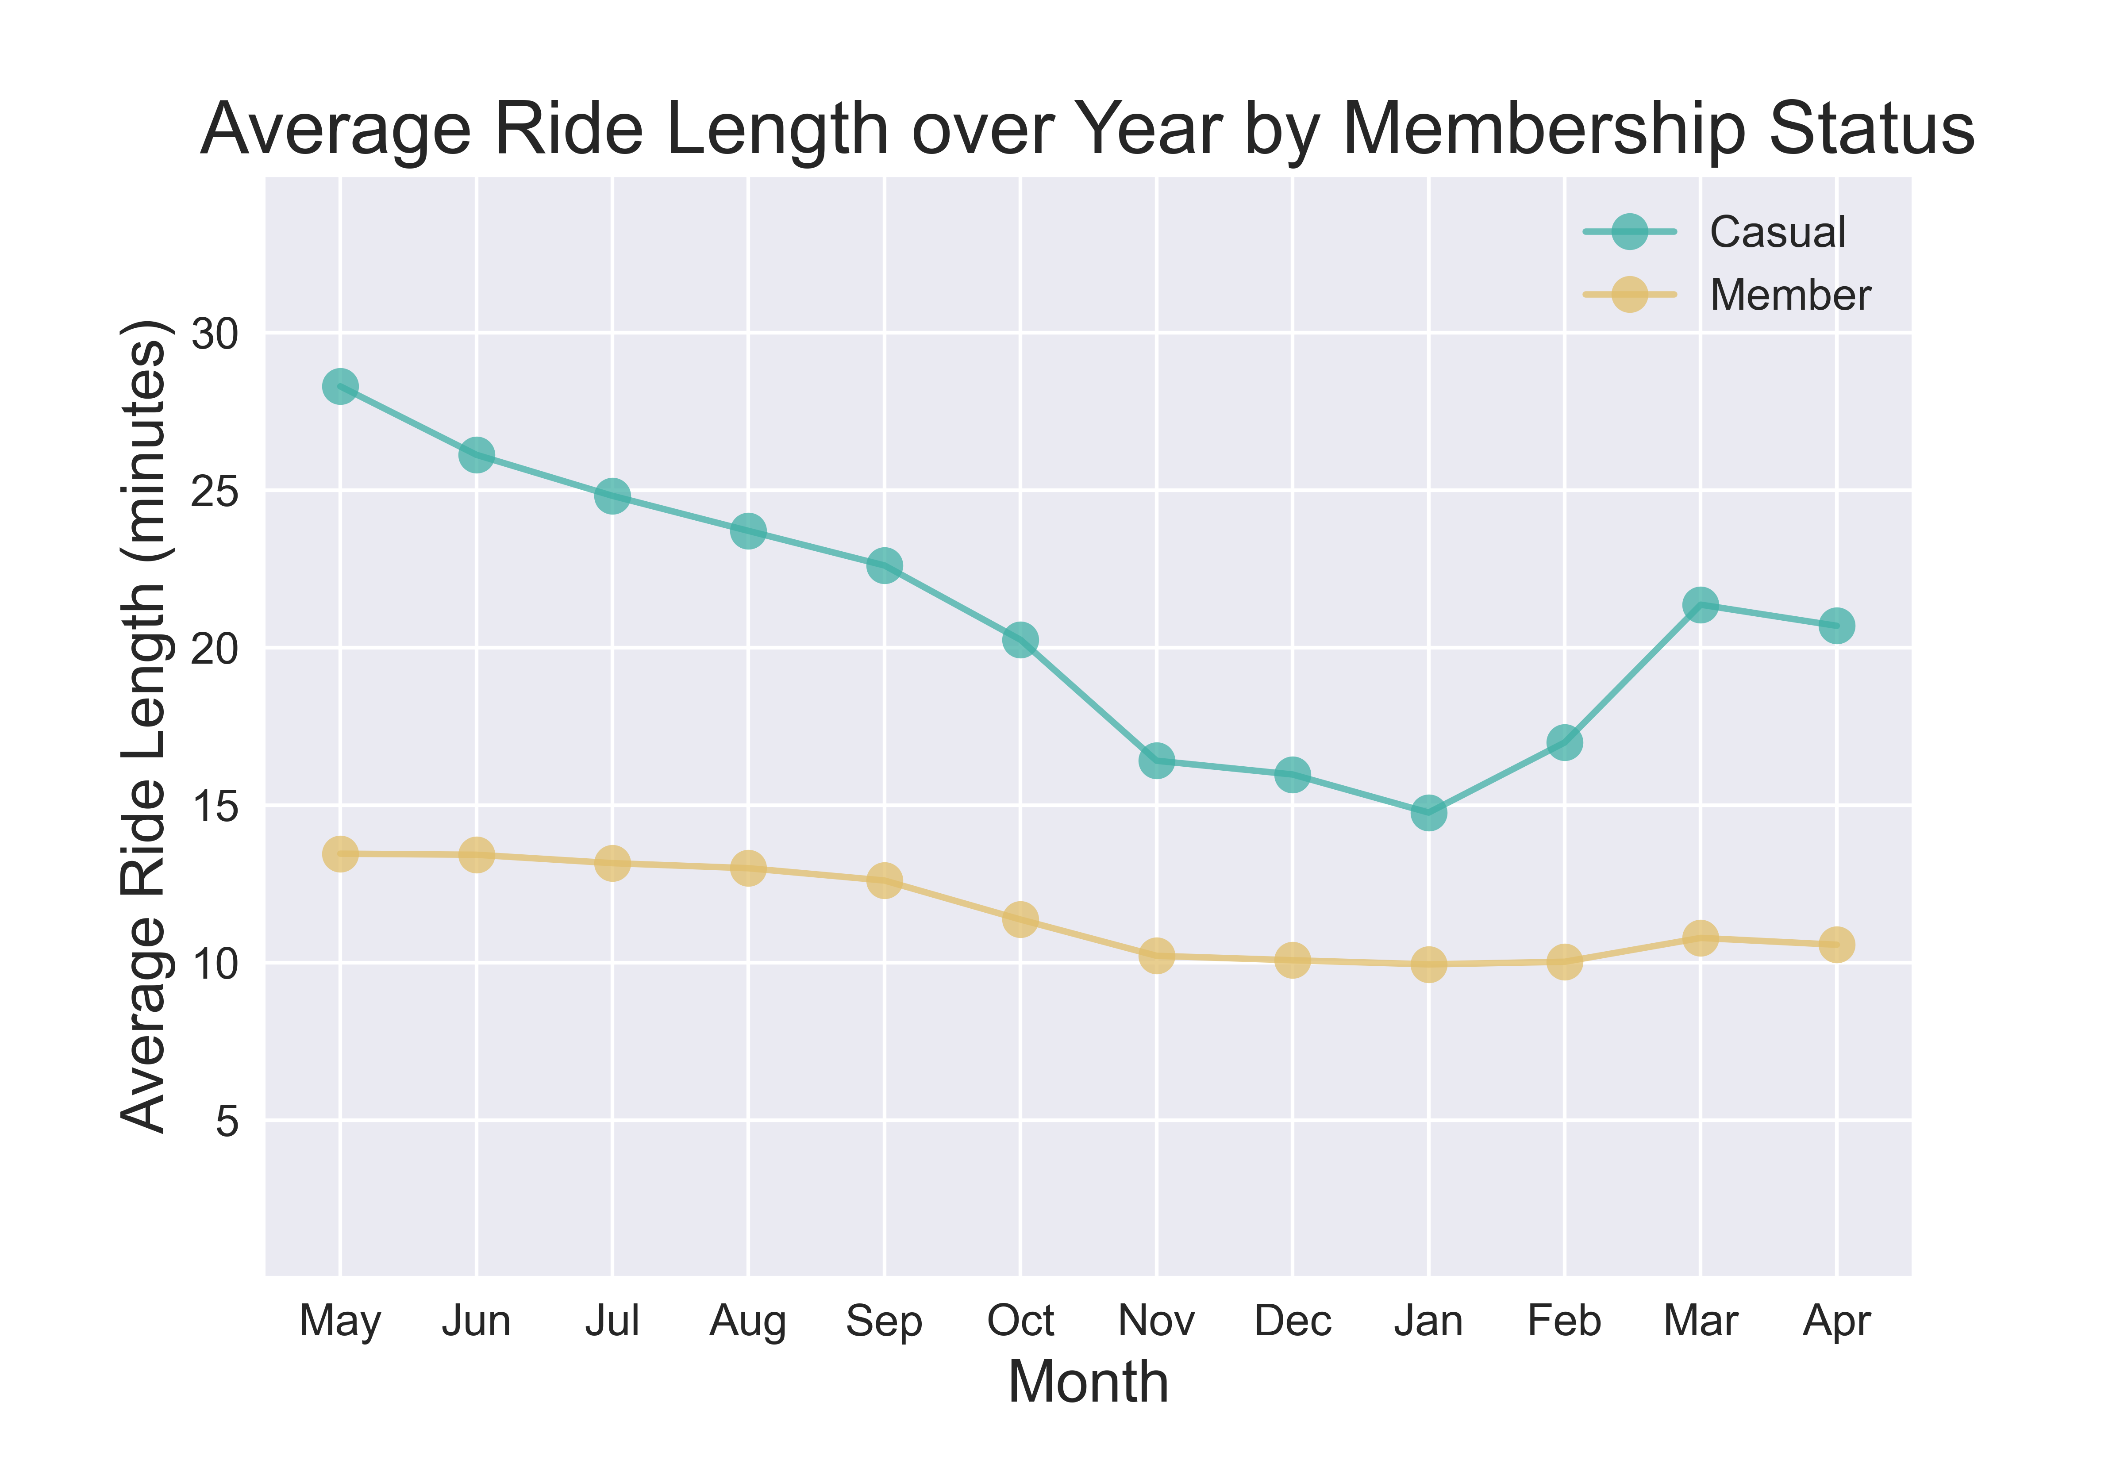
How long

Slide 18
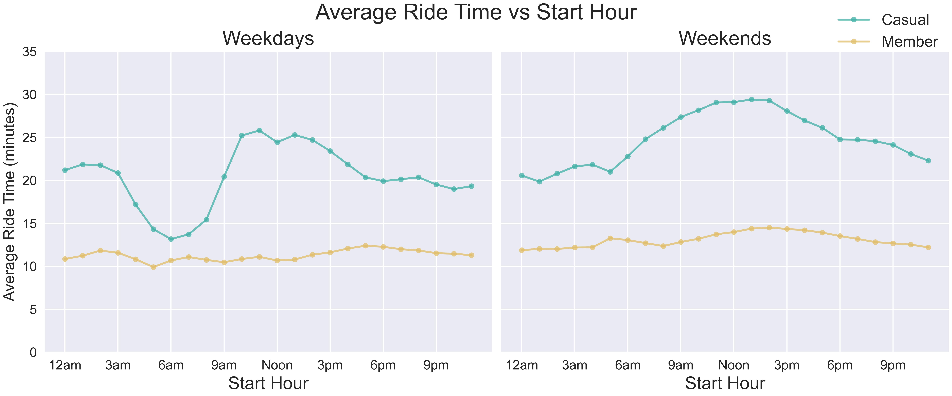
How long

Slide 19
analysis
There are four key differences and/or patterns that were identified:
What
When
How Long
Where

Slide 20
where
What areas were riders in most often?
We analyzed which stations casual riders and members interacted with most frequently to inform possible physical marketing locations.

Slide 21
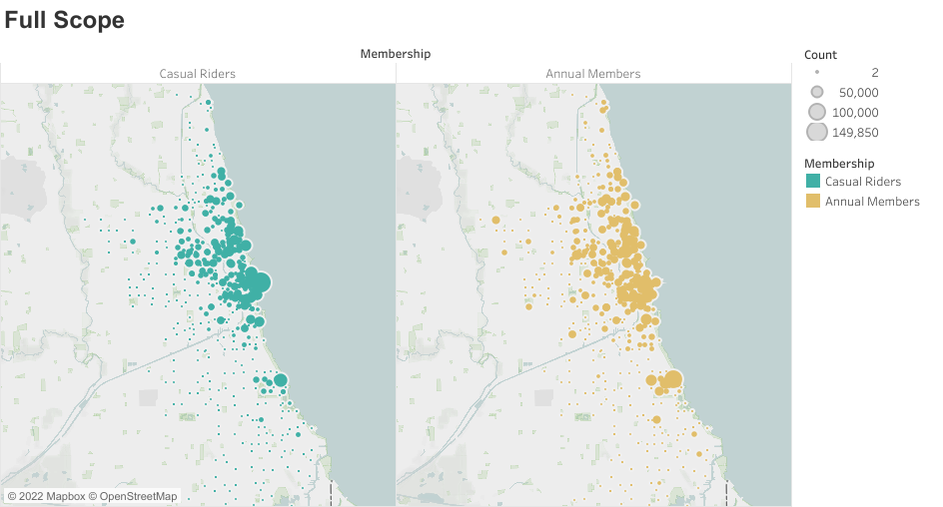
Where
Casual rides are more clustered. There is

Slide 22
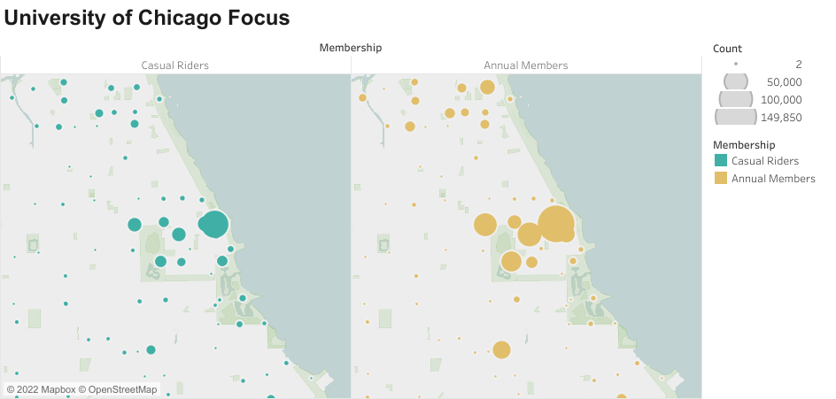
Where

